Slide 1
Importing And Securing Data In ServiceNow
SlideMake.com

Slide 2

Introduction to Importing and Securing Data in ServiceNow
Importing data is essential for populating the ServiceNow platform with relevant information.
Securing data ensures sensitive information remains protected from unauthorized access.
This presentation covers best practices for importing and securing data effectively.
Notes:
Image source: https://www.fideltech.com

Slide 3
Overview of Data Importing in ServiceNow
Data can be imported via various methods such as import sets, spreadsheets, or integrations.
Import sets are used to load external data into ServiceNow tables efficiently.
Proper mapping and transformation are key to successful data imports.
Notes:
Image source: https://www.fideltech.com

Slide 4
Types of Data Import Methods
Import Sets allow for scheduled or on-demand data loads from external sources.
IntegrationHub and APIs enable real-time data exchange with other systems.
Data import through CSV, Excel, or XML files is suitable for manual data uploads.
Notes:
Image source: https://www.fideltech.com

Slide 5
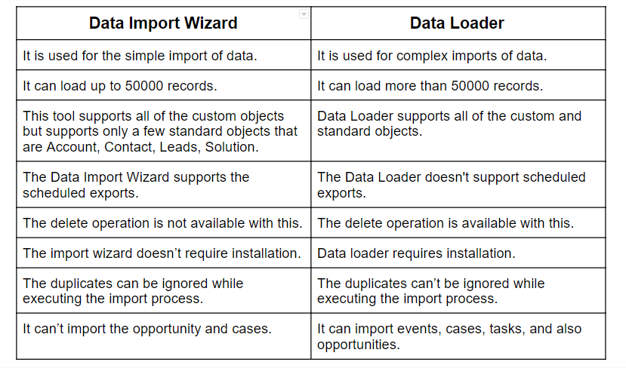
Preparing Data for Import
Data should be cleaned and validated before import to prevent errors.
Mapping fields correctly ensures data aligns with the target table structure.
Data transformation may be necessary to match ServiceNow field formats.
Notes:
Image source: https://astreait.com

Slide 6
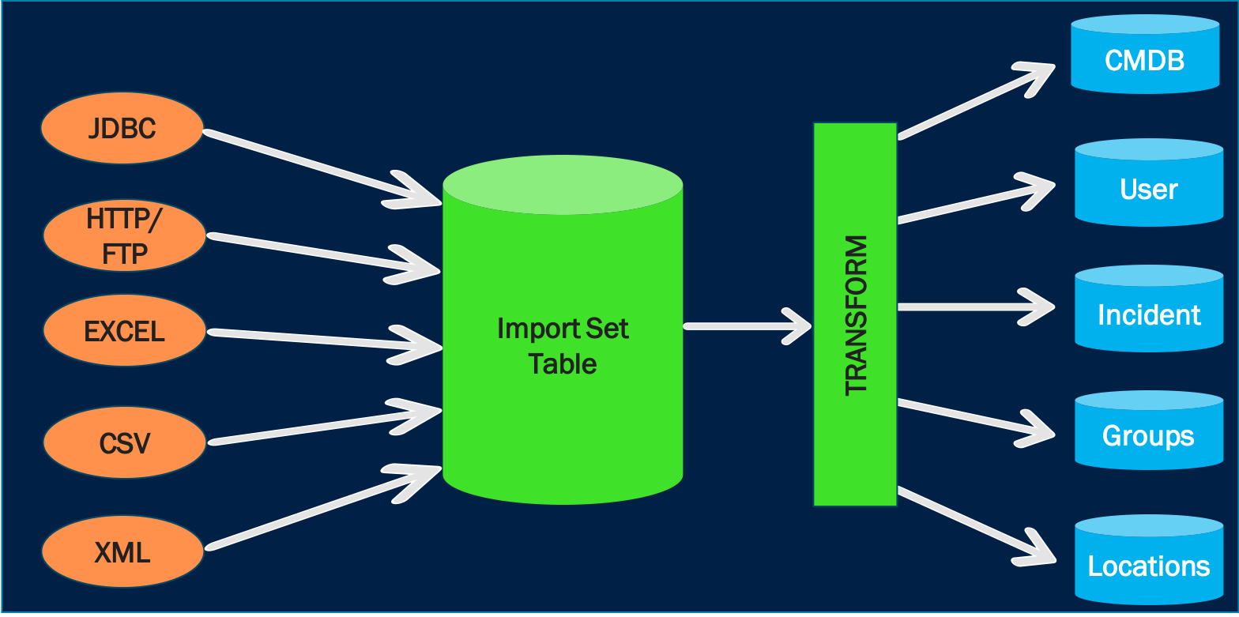
Importing Data Using Import Sets
Create an import set table and define field mappings to the target table.
Load data into the import set and run a transform map to move data into production tables.
Review import logs to identify and resolve any errors or discrepancies.
Notes:
Image source: https://istreetlabs.com

Slide 7
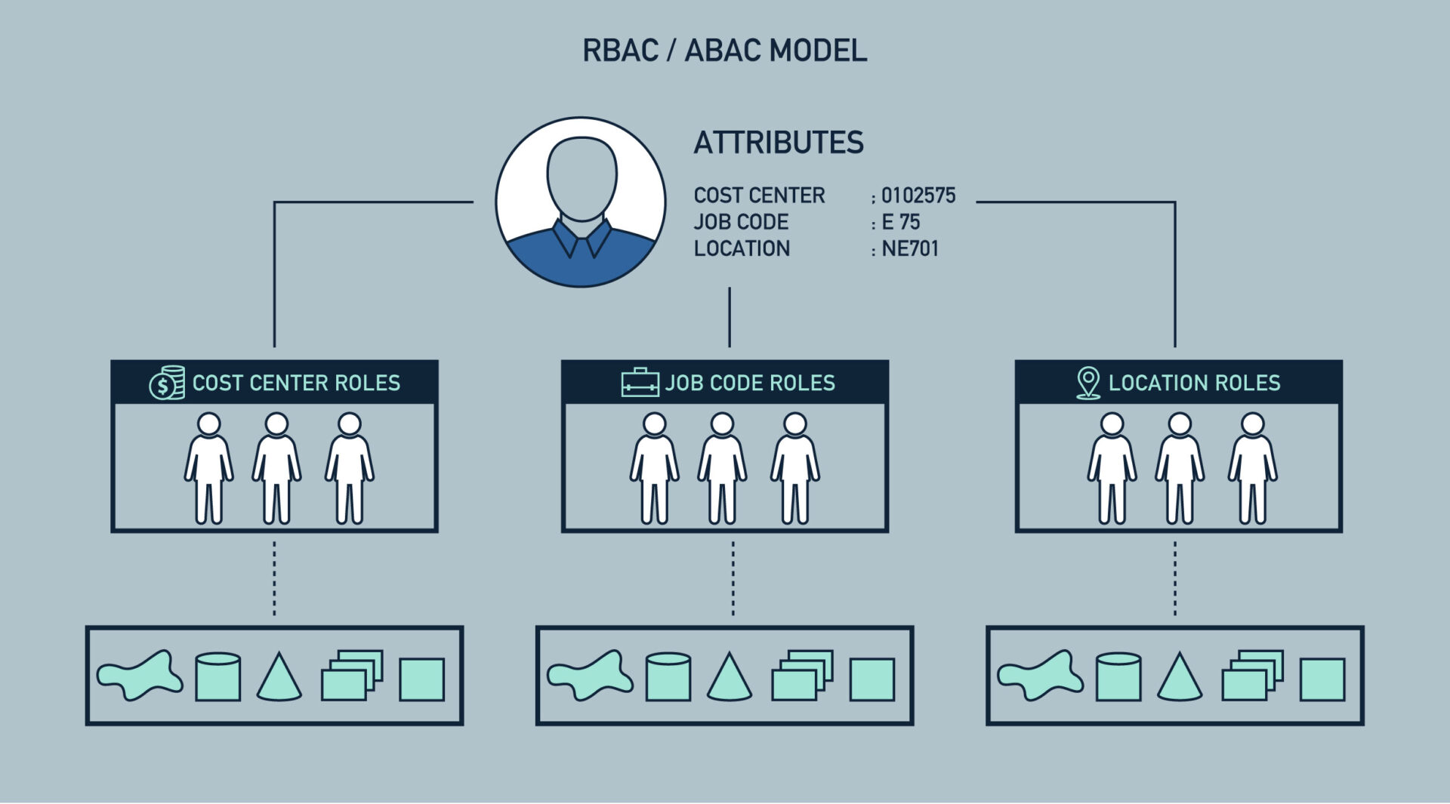
Securing Data in ServiceNow
Use role-based access controls (RBAC) to restrict data visibility and editing permissions.
Implement field-level security to protect sensitive information within records.
Regularly review permissions and audit access logs to maintain data security.
Notes:
Image source: https://cyberhoot.com

Slide 8

Best Practices for Data Security
Limit data access to only those users who need it for their roles.
Encrypt sensitive data both at rest and in transit whenever possible.
Use multi-factor authentication (MFA) for enhanced security of user accounts.
Notes:
Image source: https://www.shutterstock.com

Slide 9
Data Governance and Compliance
Establish policies for data handling, storage, and sharing in ServiceNow.
Maintain audit trails for data changes to ensure accountability.
Stay compliant with industry regulations such as GDPR or HIPAA through proper data controls.
Notes:
Image source: https://cdn2.iconfinder.com

Slide 10

Troubleshooting Data Import and Security Issues
Monitor import logs to quickly identify and resolve data load errors.
Review security settings if users cannot access needed data.
Conduct regular audits to ensure security measures are effective and up-to-date.
Notes:
Image source: https://lightrun.com

Slide 11

Conclusion and Best Practices Summary
Proper data preparation and mapping are crucial for successful imports.
Implementing robust security controls protects sensitive information effectively.
Continuous monitoring and audits help maintain data integrity and security over time.
Notes:
Image source: https://www.slidemake.com

